Slide 1


Slide 2
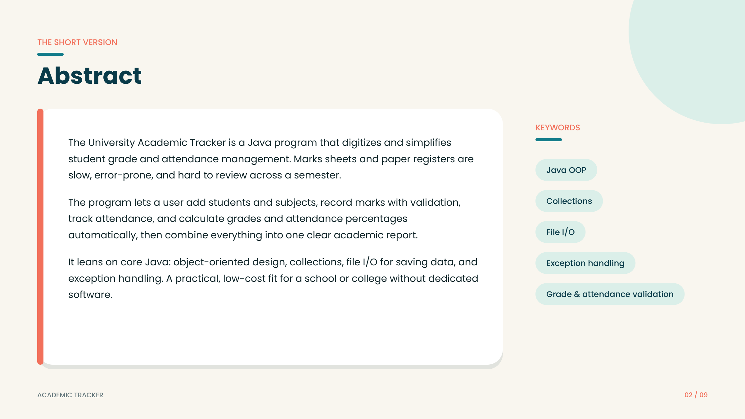
The University Grade & Attendance Tracker is a simple Java console program for managing basic student academic information.
The program accepts student details, marks in three subjects, and attendance data. It validates the entered values, calculates total marks and average, assigns a grade, and calculates attendance percentage.
The project demonstrates core Java programming concepts such as variables, primitive data types, String input, Scanner, arithmetic expressions, comparison operators, logical operators, and if–else decision making.
KEYWORDS
Core Java
Scanner & Console I/O
Variables & Data Types
Expressions & Operators
if–else & Validation

Slide 3
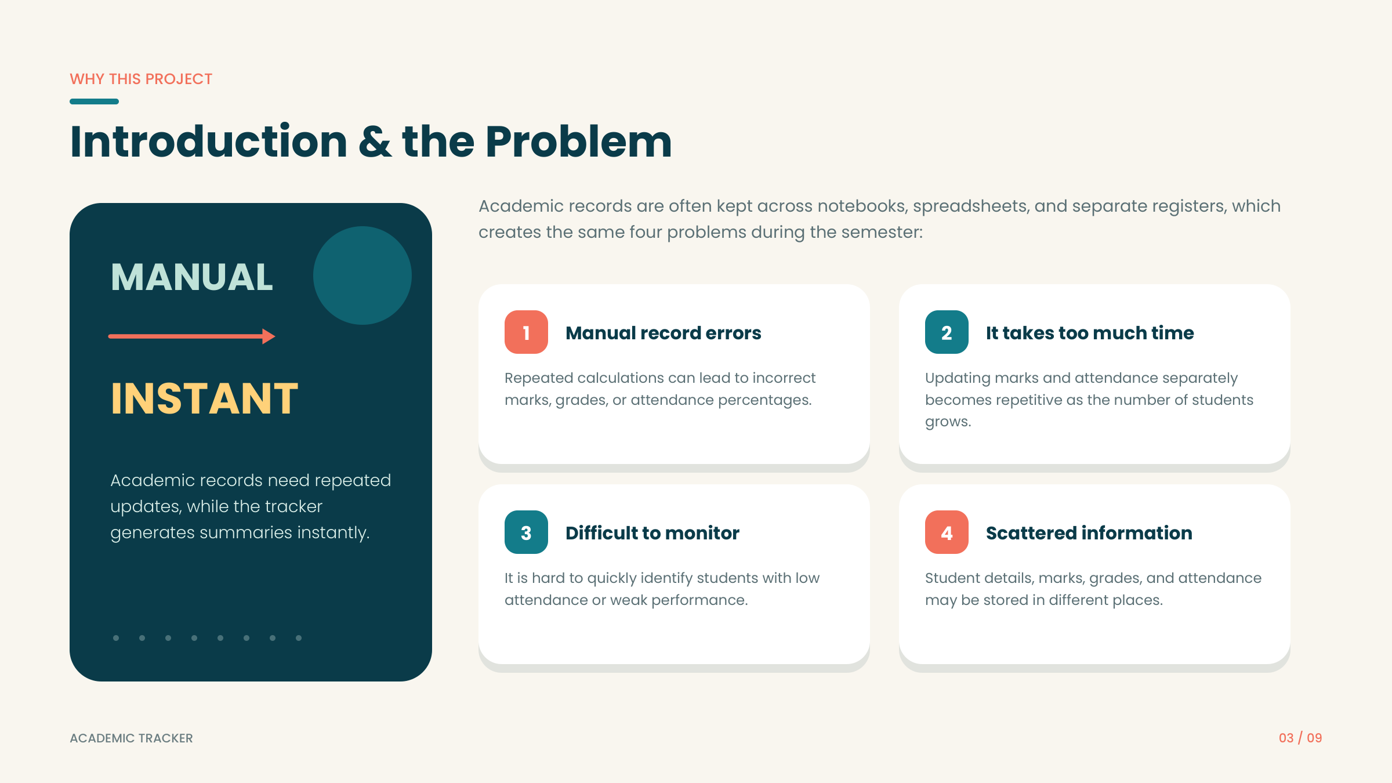
1
Manual record errors
2
Repeated calculations
1
Manual record errors
2
Repeated calculations
Marks and attendance calculations can be done incorrectly when handled manually.
Total, average, grade and attendance percentage require repeated calculations.
Marks and attendance calculations can be incorrect when handled manually.
Total, average, grade and attendance percentage require repeated calculations.
3
Validation is needed
4
Information in one flow
Validation is needed
Information in one flow
3
Invalid marks or attendance values should be detected before calculations.
4
The program collects student, marks and attendance information through one console flow.
Invalid marks or attendance values should be detected before calculations.
The program collects student, marks and attendance information through one console flow.

Slide 4
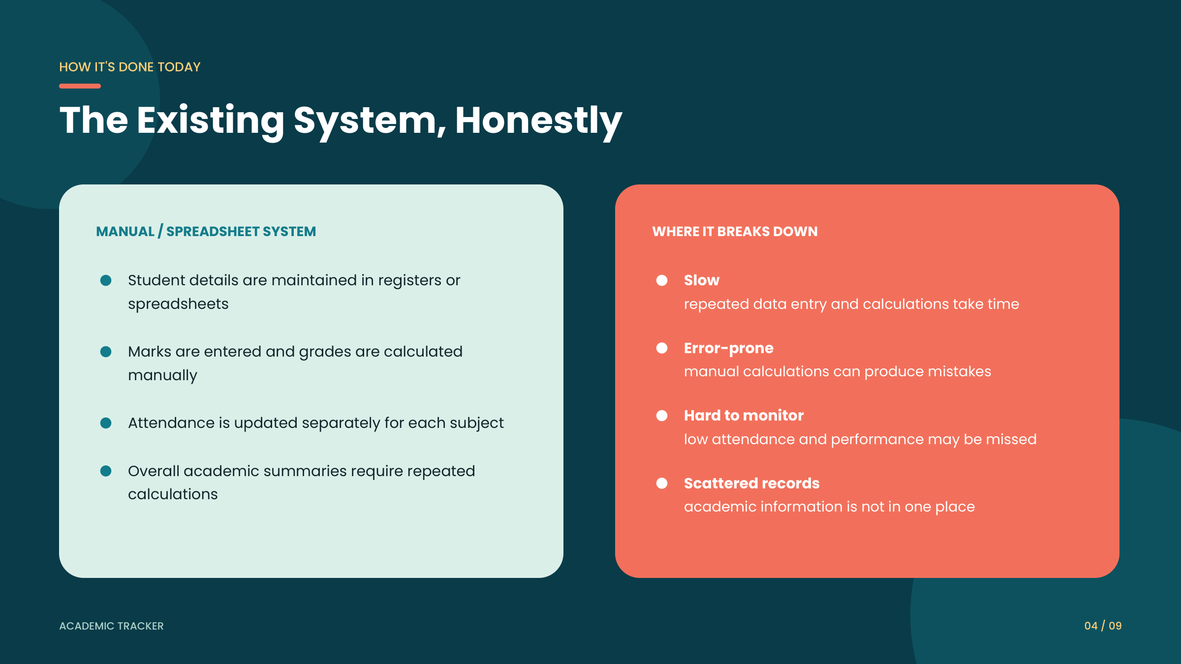

Slide 5
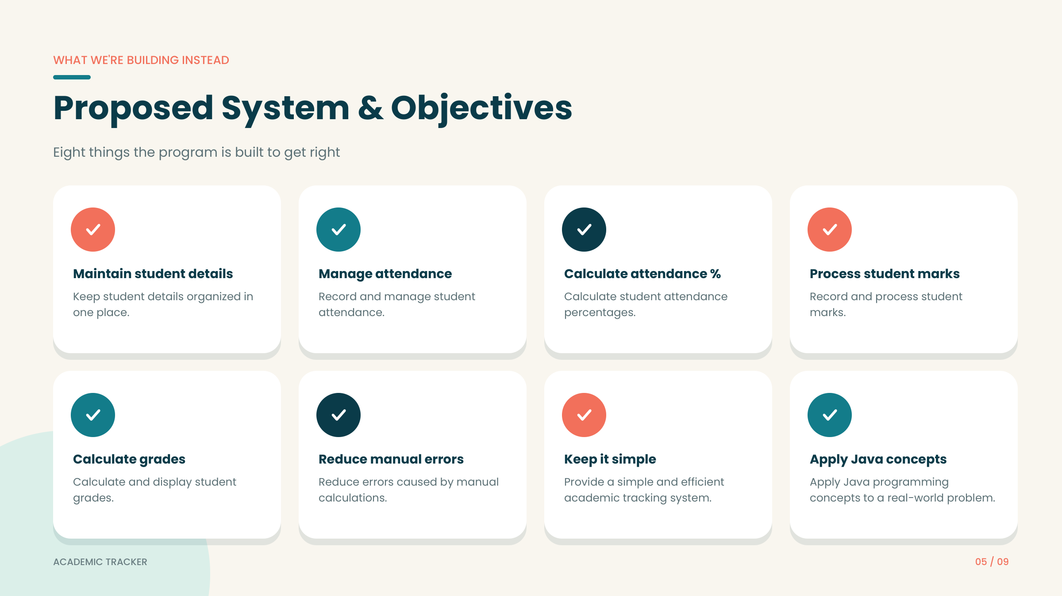
Read student details
Read student details
Accept marks
Accept marks
Validate input
Validate input
Calculate performance
Calculate performance
Accept ID, name and department using Scanner.
Accept ID, name and department using Scanner.
Take marks for Java, Maths and Digital Logic.
Take marks for Java, Maths and Digital Logic.
Check that marks stay between 0 and 100.
Check that marks stay between 0 and 100.
Find total marks and average.
Find total marks and average.
Assign grade
Assign grade
Track attendance
Track attendance
Display result
Display result
Apply Core Java
Apply Core Java
Use if–else conditions to determine the grade.
Use if–else conditions to determine the grade.
Calculate attendance percentage and eligibility.
Calculate attendance percentage and eligibility.
Show the student's academic information clearly.
Show the student's academic information clearly.
Demonstrate variables, expressions and decision making.
Demonstrate variables, expressions and decision making.

Slide 6
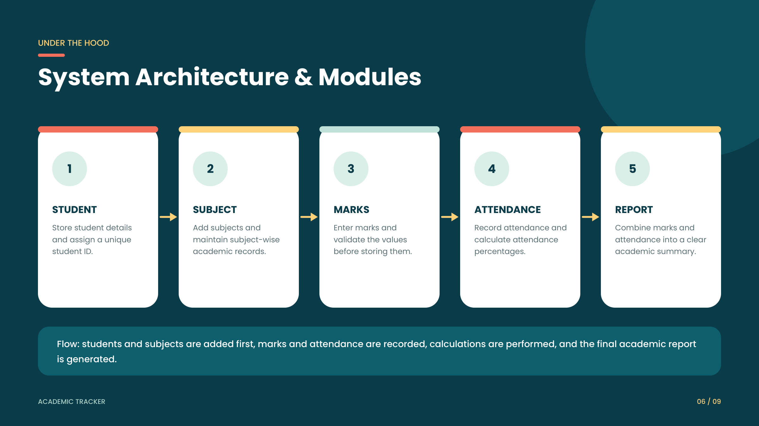
PROGRAM FLOW
1
2
3
4
5
6
Student Input
Marks Input
Marks Validation
Grade Calculation
Attendance
Final Display
ID, name and department
Java, Maths and Digital Logic
Check 0–100 range
Total → average → grade
Classes → percentage → eligibility
Student details + results
Scanner input → validation → calculations → conditional decisions → console output

Slide 7
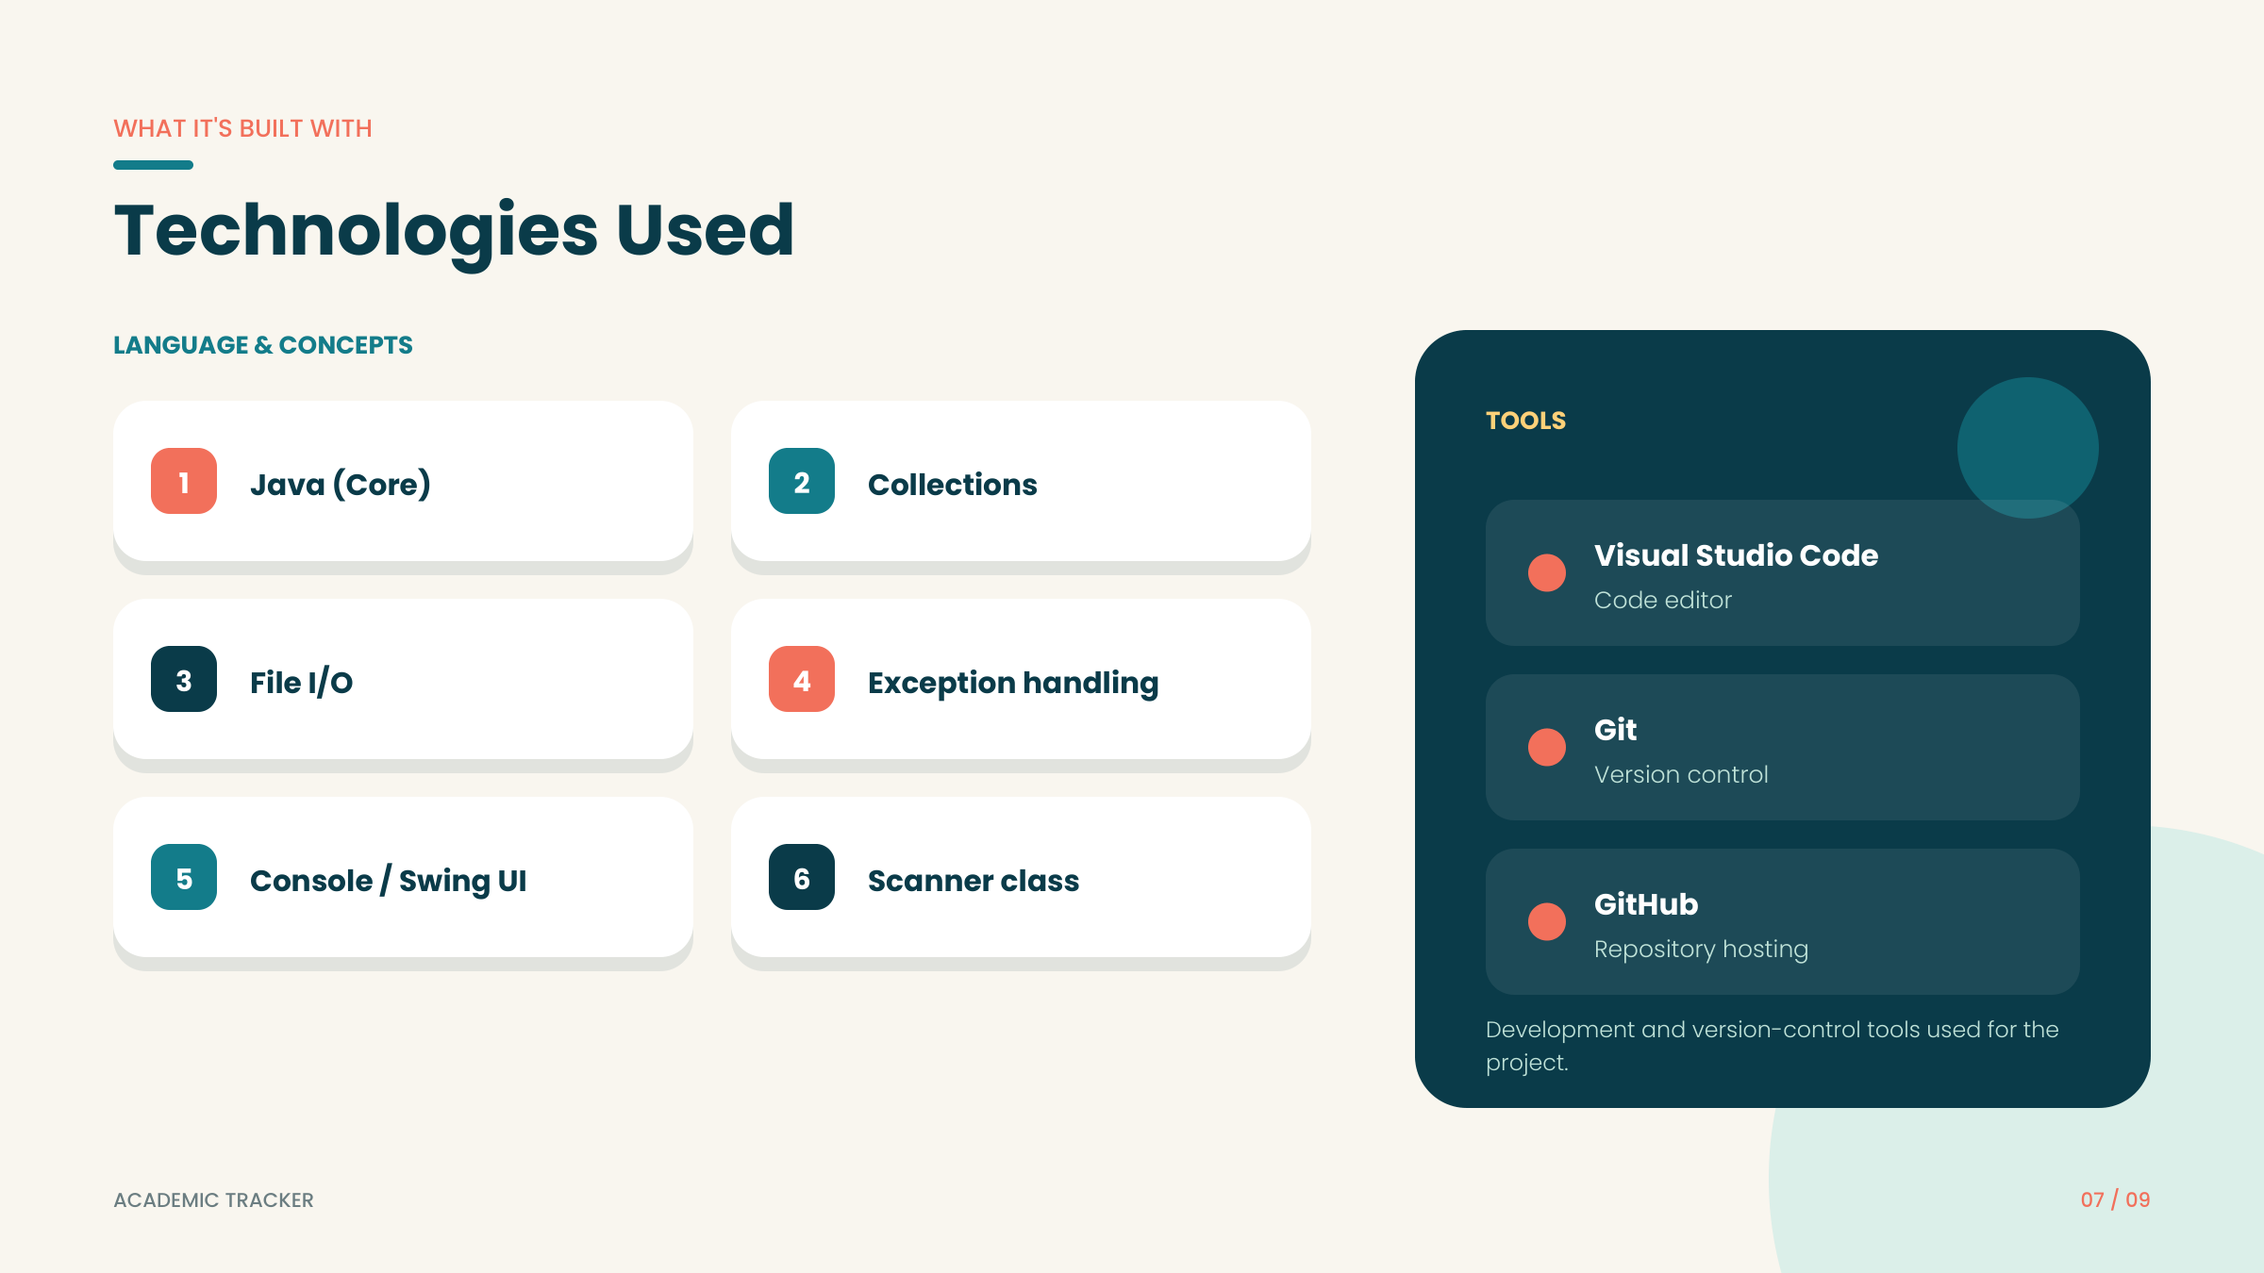
Java Core
Scanner
TOOLS USED
Main programming language
Console input from the user
Visual Studio Code
Primitive types
String
int and double for numeric values
Student name and department
Java JDK
Operators
if–else
Arithmetic, comparison and logical operators
Validation, grade and attendance decisions
Git / GitHub
The project itself is implemented as Java source code; no database, file storage, collections, GUI or external API is used in the current version.

Slide 8
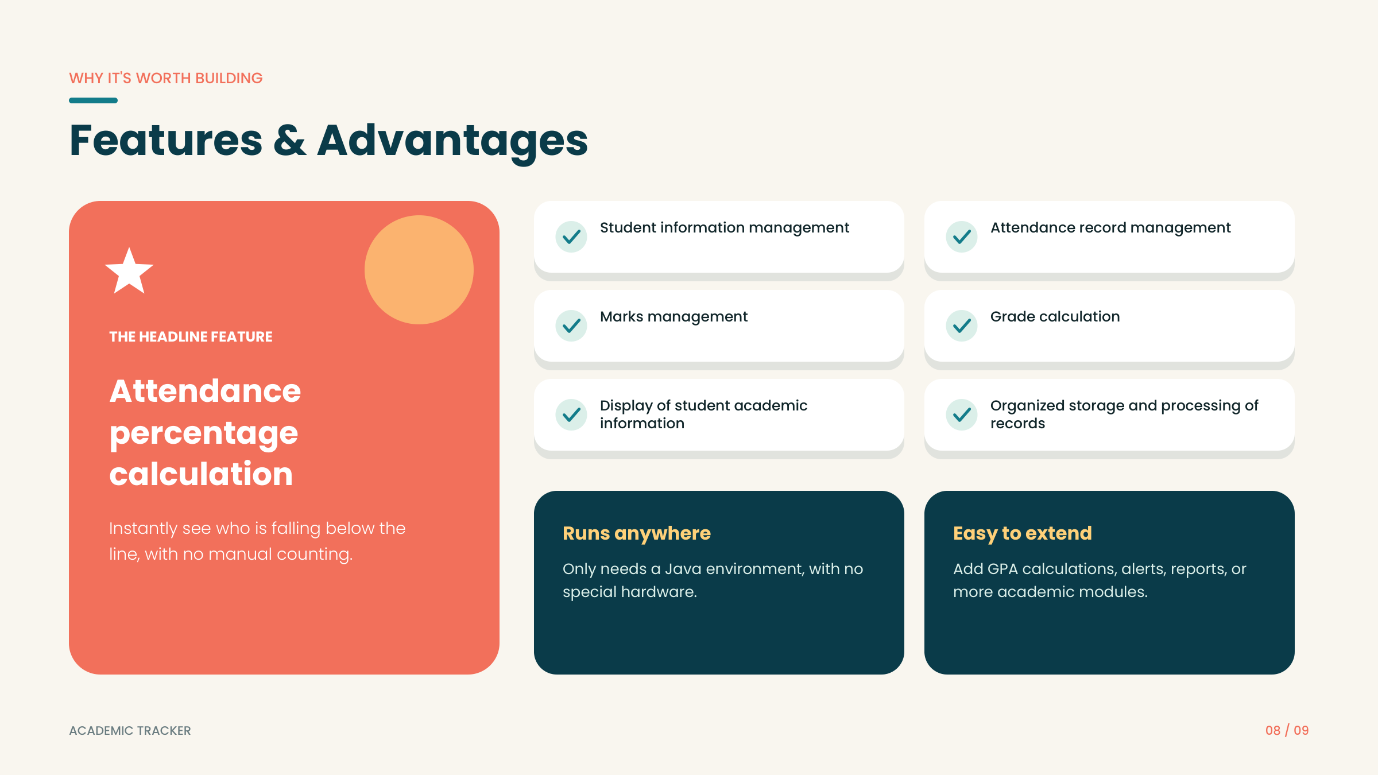
Student details
Student details
Reads ID, name and department.
Reads ID, name and department.
Marks input
Marks input
Accepts marks for three subjects.
✓
Accepts marks for three subjects.
✓
✓
✓
Marks validation
Marks validation
Rejects values outside 0–100.
Rejects values outside 0–100.
Total & average
Total & average
Calculates total marks and average.
✓
Calculates total marks and average.
✓
✓
✓
Grade calculation
Grade calculation
Assigns A+, A, B, C, D or Needs Improvement.
Assigns A+, A, B, C, D or Needs Improvement.
Attendance calculation
Attendance calculation
Calculates attendance percentage.
✓
Calculates attendance percentage.
✓
✓
✓
Eligibility check
Eligibility check
Checks whether attendance is at least 75%.
Checks whether attendance is at least 75%.
Console output
Console output
Displays student and result information.
✓
Displays student and result information.
✓
✓
✓

Slide 9
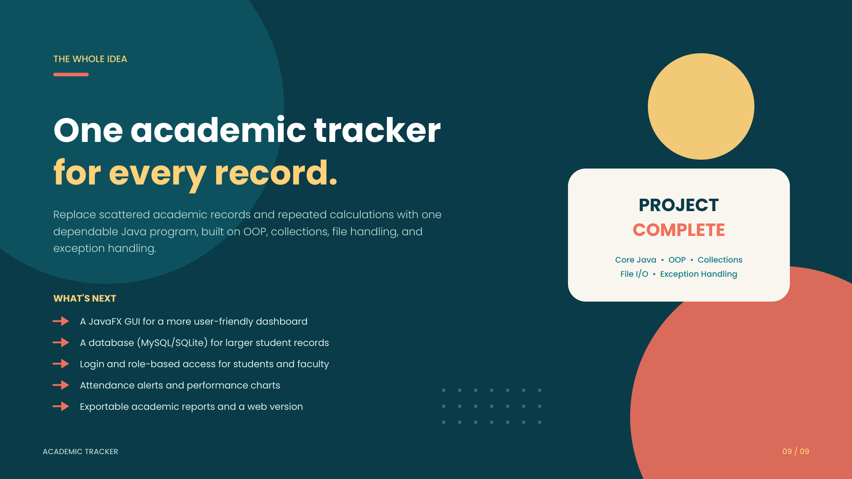
WHAT THE CURRENT PROJECT DOES
FUTURE EXTENSIONS
FUTURE EXTENSIONS
The current project is a simple Java console application that demonstrates core programming fundamentals.
It collects student information, validates marks and attendance, calculates academic results, and displays the output.
The project focuses only on the Java code developed for the current mini-project.
• Methods for modular design
• Classes and objects
• File/database storage
• GUI interface
• Multiple student records
• Methods for modular design
• Classes and objects
• File/database storage
• GUI interface
• Multiple student records
These are future improvements, not features of the current Java code.
These are future improvements, not features of the current Java code.

